Slide 1
Types of homes

Slide 2
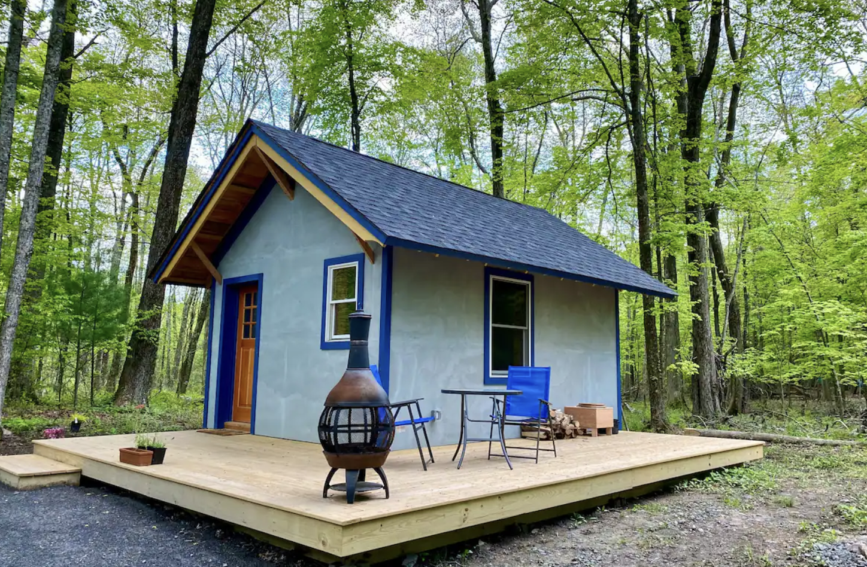
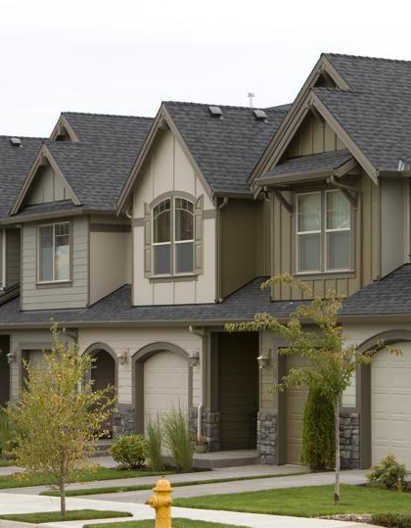
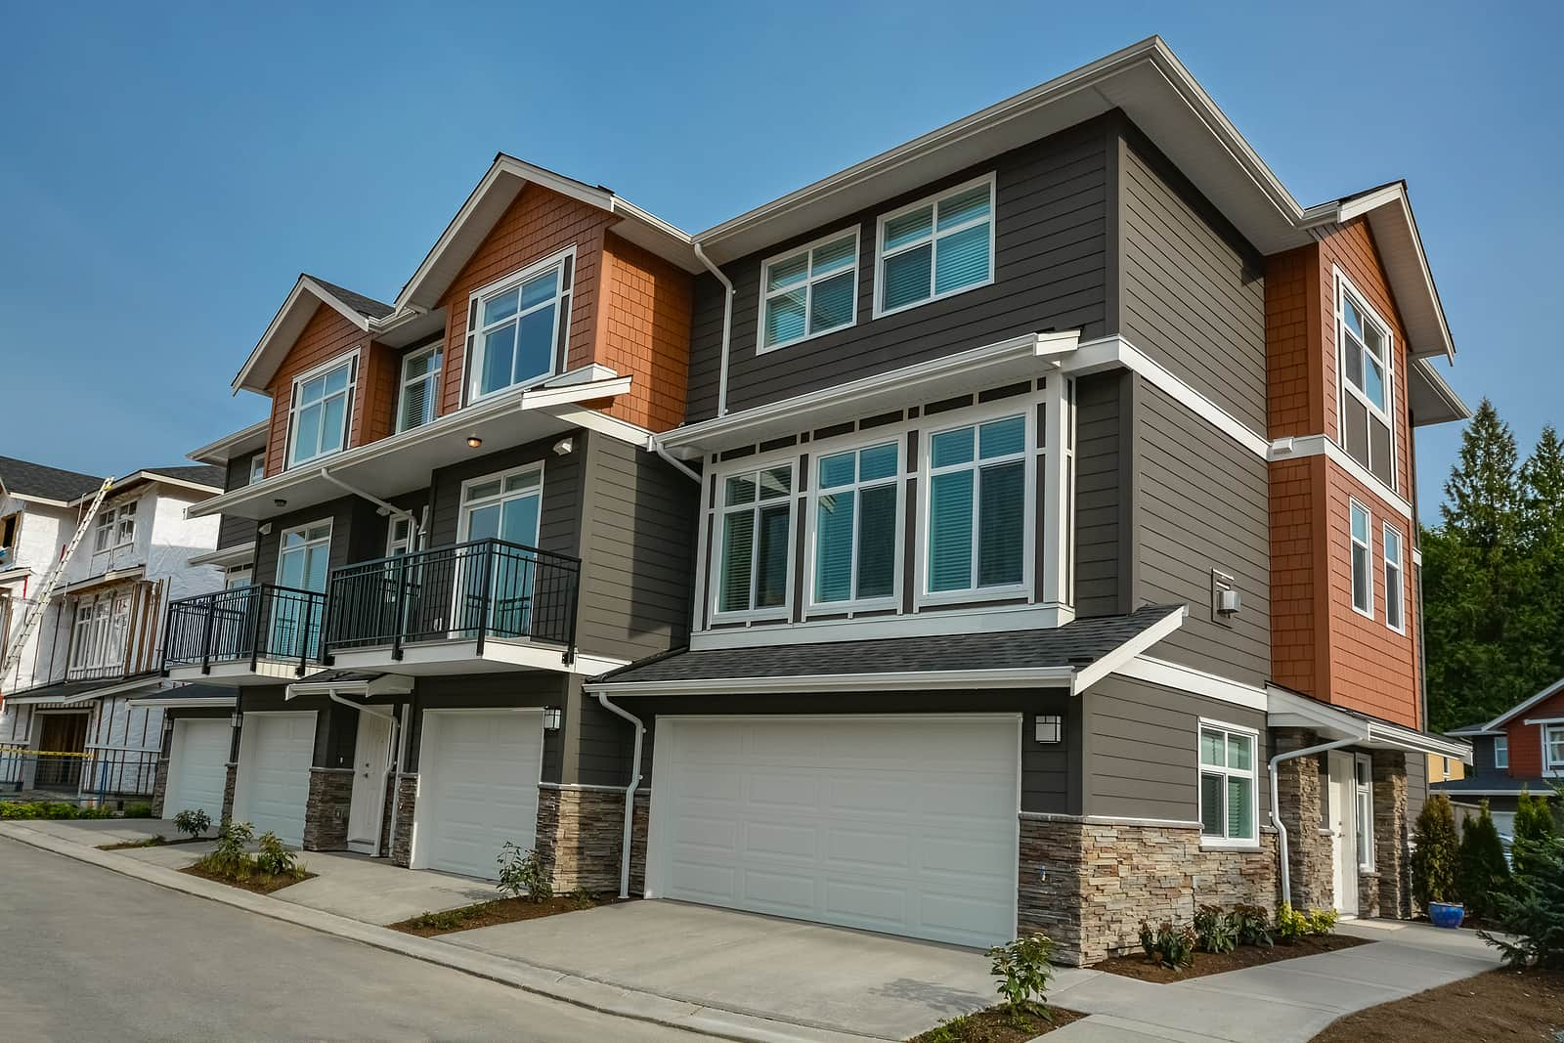
Types of homes
There are various types of homes, including:
Single-family homes: Detached houses for one family.
Apartments/Condos: Multi-unit buildings with individual living spaces.
Townhouses: Connected homes in a row or block.
Duplexes/Triplexes: Houses divided into two or three separate units.
Tiny houses: Small, compact dwellings usually under 400 square feet.
Cottages: Small, cozy houses, often in rural or scenic areas.
Duplexes/Triplexes: Houses divided into two or three separate units.

Slide 3
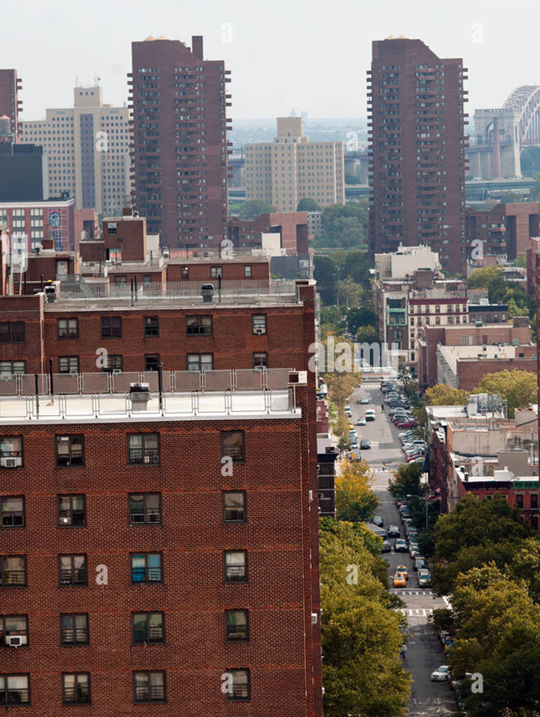
Living in a Flat:
Advantages:
Affordability: Flats are often more affordable than houses, making them accessible to a broader range of people.
Community Living: Proximity to neighbors can foster a sense of community.
Amenities: Many flats come with shared amenities like gyms, pools, and common spaces.
Maintenance: External maintenance is typically managed by the building management.

Slide 4
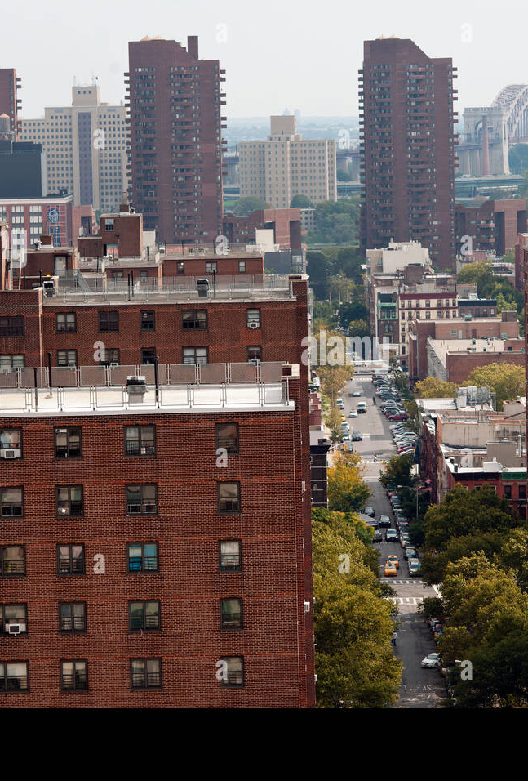
Living in a Flat:
Disadvantages:
Space: Limited space compared to houses, especially for families.
Noise: Increased potential for noise from neighbors in close proximity.
Limited Customization: Restrictions on personalizing or modifying the property.
Parking: Limited or expensive parking options, depending on location.

Slide 5
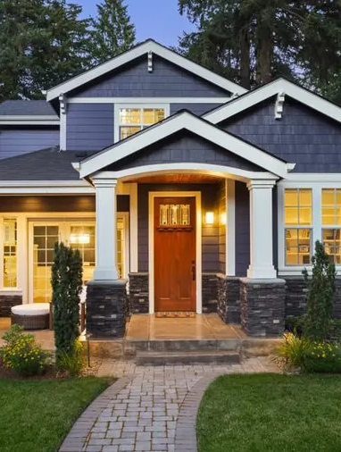
Living in a House:
Advantages:
Space: More living space, both indoors and outdoors, providing room for personalization.
Privacy: Greater privacy due to distance from neighbors.
Customization: Freedom to modify and personalize the property.
Outdoor Space: Houses often come with yards or gardens.

Slide 6
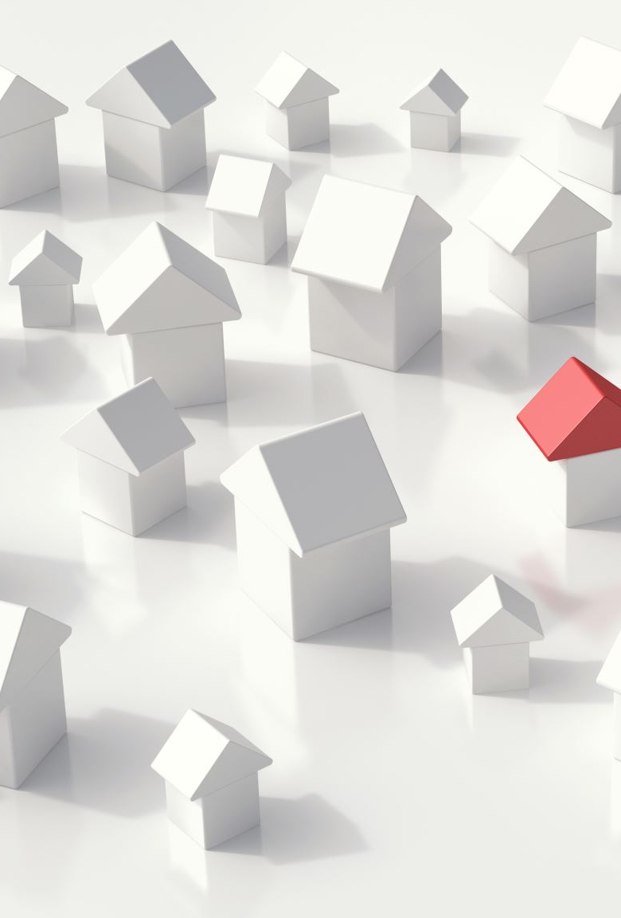
Living in a House:
Disadvantages:
Cost: Generally, more expensive to buy and maintain than flats.
Maintenance: Responsible for the maintenance of the entire property.
Isolation: Houses in remote areas might lack the sense of community found in urban flats.
Security: Depending on the location, houses might require additional security measures.

Slide 7
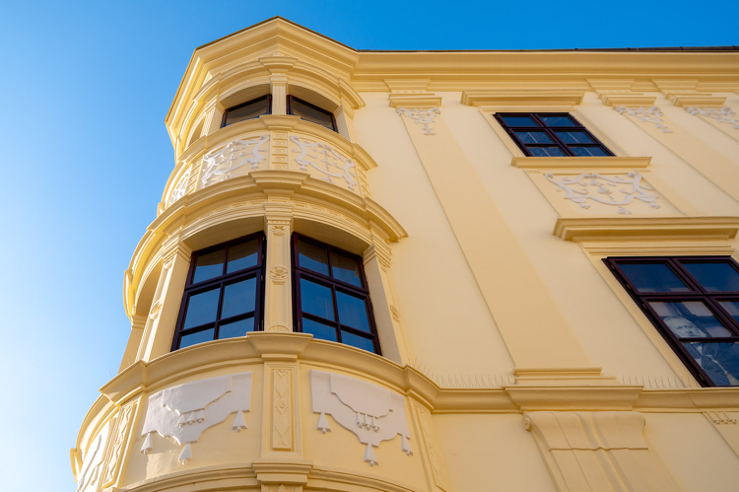
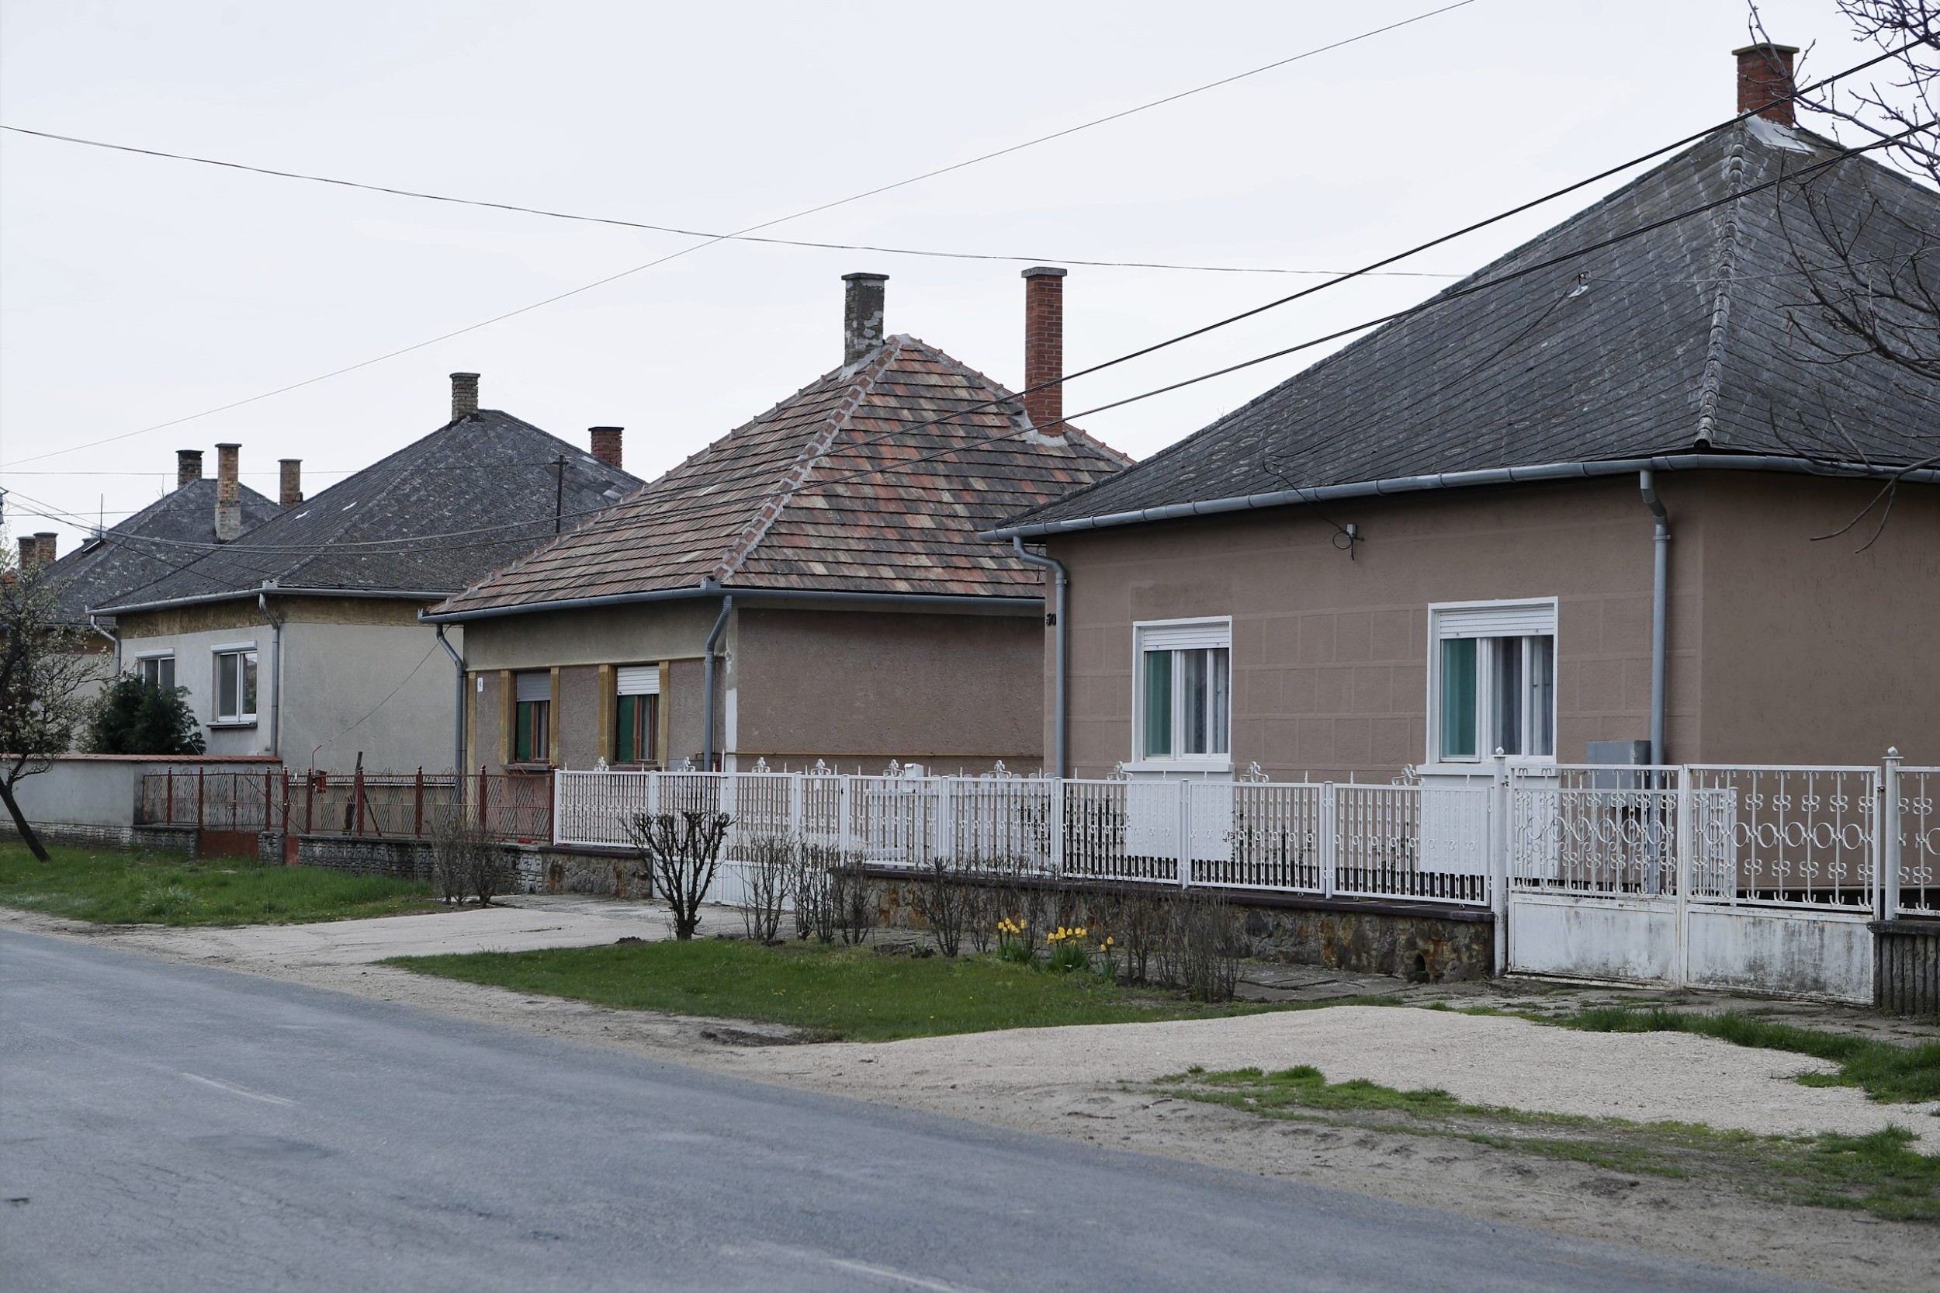
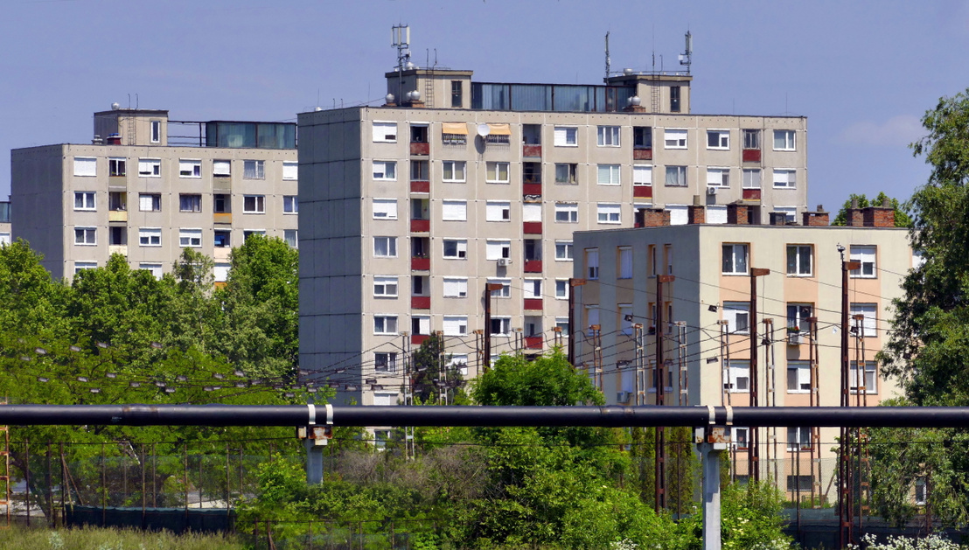
Typical homes in Hungary
Apartments: Many Hungarians live in apartment buildings, especially in urban areas like Budapest. These can range from historic buildings to more modern complexes.
Detached Houses: In suburban and rural areas, detached houses are common. These can vary in size and style, from traditional to contemporary.
Historic Homes: Hungary has a rich architectural history, so you can find homes with traditional designs influenced by various periods.
Panel Buildings: In the mid to late 20th century, panel buildings (blocks of flats with pre-fabricated panels) were constructed to address housing shortages. Many people still live in these.
Rural Cottages: In the countryside, you may find charming cottages, often with a focus on agricultural activities.
Renovated Buildings: Hungary has seen a trend of renovating historic buildings into modern apartments, combining traditional architecture with contemporary interiors.

Slide 8
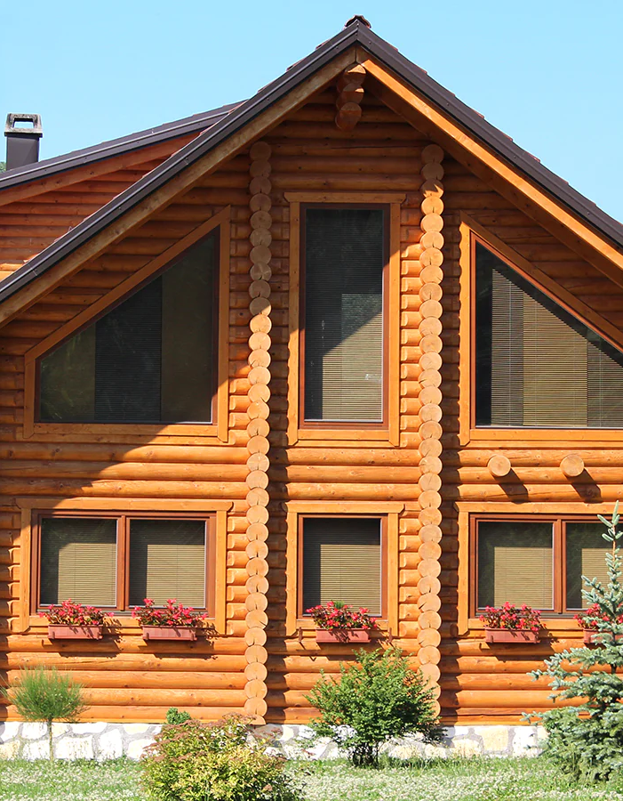
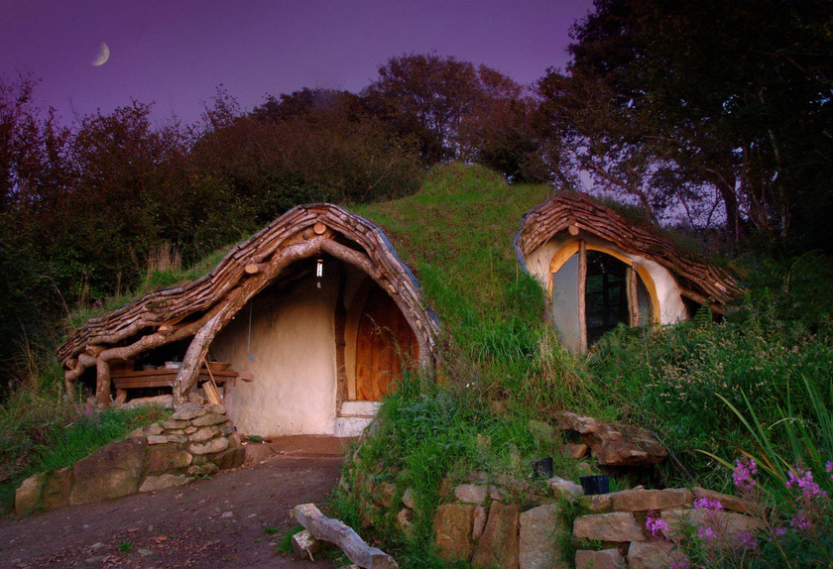
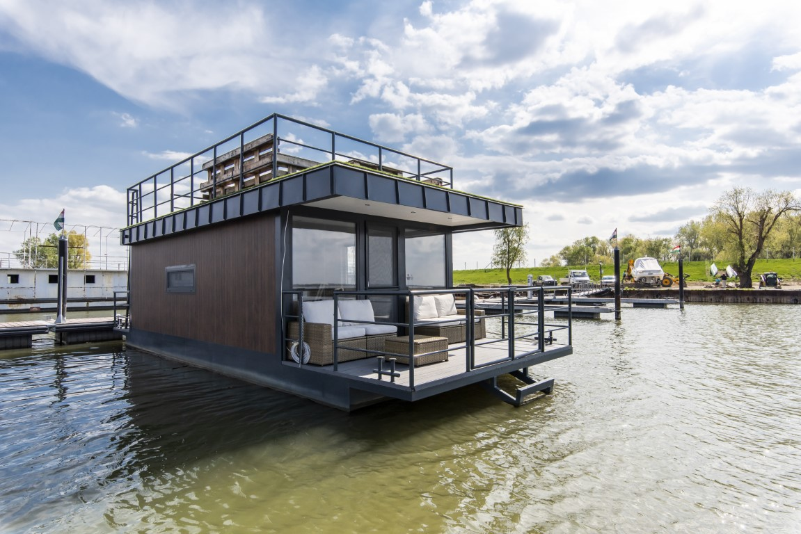
Exceptional places of living
Treehouses: Elevated dwellings in trees, offering a unique and often eco-friendly living experience.
Houseboats: Floating homes on water, providing a tranquil and unconventional lifestyle.
Underground Homes: Built into the earth, these homes offer energy efficiency and a unique architectural experience.
Converted Spaces: Living in repurposed structures like old churches, warehouses, or industrial buildings for a distinctive living environment.
Floating Cities: Experimental floating communities designed to adapt to rising sea levels and offer sustainable living.
Earthships: Sustainable, off-grid homes built using recycled materials and incorporating natural elements for energy efficiency.

Slide 9
Thank you for your attention!

Slide 10
Sources
Pictures: The source of the images is attached to the images
https://www.rocketmortgage.com/learn/types-of-houses?fbclid=IwAR1rSbMt6DRf_OHAccQl-bSUlHmV2PnCUGG-HG-qC_4KZwKR-S8Hhi3UfTo
https://manajemen.uma.ac.id/2021/02/advantages-and-disadvantages-of-living-in-a-flat/?fbclid=IwAR0B_BsTe9VmPe5hyga4sgFM5L1bDoGnTm1Bgn6k-tadRmjc-E9mboc0sv4
https://chat.openai.com/

